Slide 1
Differences between software and hardware Understanding the Fundamental Components of Computing

Slide 2
What Are Hardware and Software?
Hardware:
The physical components of a computer.
Software:
The set of instructions or programs that tell the hardware what to do.

Slide 3
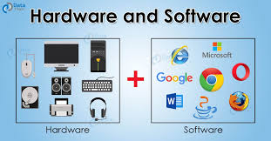

Slide 4
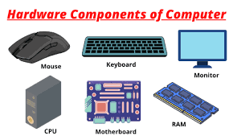
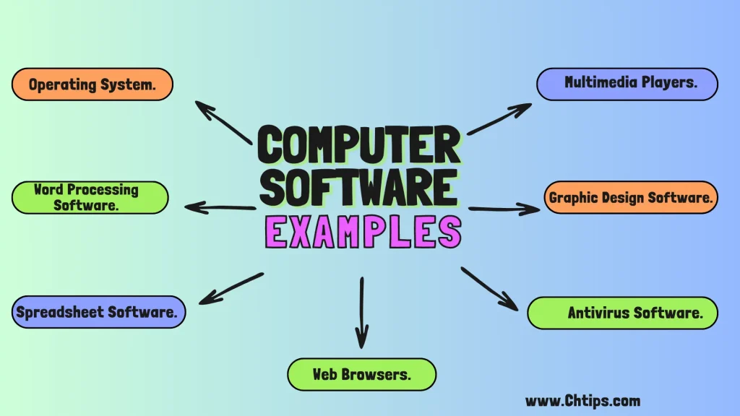
Hardware and Software Examples
examples of hardware:
CPU, RAM, Hard Drive, Monitor, Keyboard.
examples of software:
Operating System,
Web Browser, Word Processor,
Games, Apps.

Slide 5
Characteristics of Hardware
Physical, tangible components.
Has specific functions (e.g., CPU processes data, RAM stores data temporarily).
Subject to wear and tear over time. Can be upgraded or replaced.

Slide 6
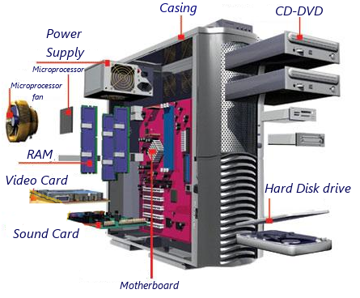

Slide 7
Characteristics of Software
Intangible, a collection of code and instructions.
Exists in various forms (system software, application software, utility software).
Can be updated without replacing physical parts.
Dependent on hardware to function.

Slide 8
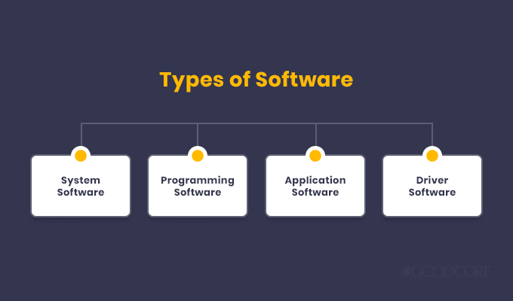

Slide 9
Key Differences Between Hardware and Software
Tangibility: Hardware is tangible; software is intangible.
Functionality: Hardware performs basic physical operations; software gives instructions.
Maintenance: Hardware may need physical repairs; software requires updates and patches.
Upgradability: Hardware upgrades involve new parts; software upgrades are usually downloads or installations.

Slide 10
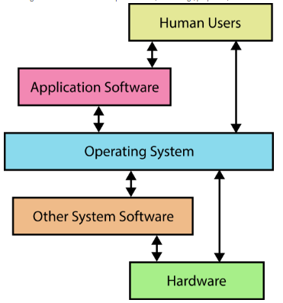
Interdependence of Hardware and Software (How Hardware and Software Work Together)
Hardware needs software to operate; software requires hardware to run.
Example: A video game (software) needs a console or PC (hardware).

Slide 11
Real-World Example(Smartphone)
Hardware: Processor, Camera, Battery, Screen.
Software: Operating System (Android/iOS), Apps (Messaging, Social Media)

Slide 12
Evolution of Hardware and Software
Hardware: From large mainframes to compact smartphones.
Software: From simple command-line interfaces to advanced graphical and AI-driven applications.

Slide 13
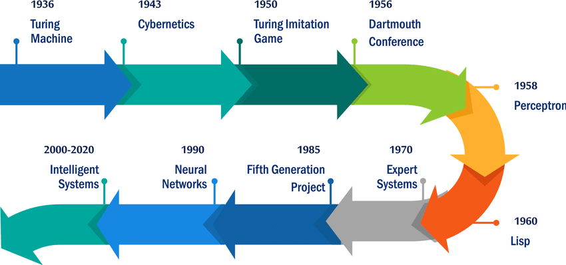

Slide 14
Conclusion
Summary of the primary differences between hardware and software.
Importance of both for a fully functional computing experience.
Final thought on the future of hardware and software interdependence.

